Slide 1
Dynamic Programming (DP) Chris Amato Northeastern University with some slides from Rob Platt, Lawson Wong and UAlberta
Notes:
1

Slide 2
Announcements
Exercise 2 (MDPs) due Monday 9/30
Exercise 3 (DP) out soon
Due Wednesday Oct 9

Slide 3



Markov Decision Processes
An MDP is defined by:
A set of states s ∈ S
A set of actions a ∈ A
A transition function T(s, a, s’)
Returns probability that action a from state s leads to s’, i.e., P(s’| s, a)
A reward function R(s, a, s’)
Sometimes just R(s) or R(s’)
A start state
Maybe terminal state(s)
Objective: calculate a strategy for acting so as to maximize the (discounted) sum of future rewards.
We will calculate a policy that will tell us how to act
Notes:
In search problems: did not talk about actions, but about successor functions --- now the information inside the successor function is unpacked into actions, transitions and reward
Write out S, A, example entry in T, entry in R
Reward function different from the book : R(s,a,s’)
In book simpler for equations, but not useful for the projects.
Need to modify expectimax a tiny little bit to account for rewards along the way, but that’s something you should be able to do, and so you can already solve MDP’s (not in most efficient way)

Slide 4
Policies
For MDPs, we want an optimal policy π*: S → A
A policy π gives an action for each state
An optimal policy is one that maximizes expected returns if followed
Optimal policy when R(s, a, s’) = -0.03 for all non-terminals s (cost of living)
Notes:
Lookup table
Dan has a DEMO for this.

Slide 5
Policies
For MDPs, we want an optimal policy π*: S → A
A policy π gives an action for each state
An optimal policy is one that maximizes expected returns if followed
Optimal policy when R(s, a, s’) = -0.03 for all non-terminals s (cost of living)
A policy is a rule for selecting actions:
If agent is in this state, then take this action
A policy can be stochastic:
The goal of this lecture is to develop new ways of calculating an optimal policy
(assuming we know the full MDP model–no learning yet)
Notes:
Lookup table
Dan has a DEMO for this.

Slide 6
Calculating an optimal policy
The goal of this lecture is to develop new ways of calculating an optimal policy
first, develop methods of calculating value function for an arbitrary policy (policy evaluation)
then, develop methods of calculating an optimal value function (and policy) by iteratively calculating value function and then improving policy
Many of the RL method will work to approximate the DP methods we talk about
Notes:
6

Slide 7
Recall: Value Function
Value of state when acting according to policy :
Value of a state == expected return from that state
if agent follows policy
Notes:
7

Slide 8
Recall: Value Function
Value of state when acting according to policy :
Value of a state == expected return from that state
if agent follows policy
But, how do we compute the value function?
(for a particular policy)
Notes:
8

Slide 9
Recall: Value Function
Value of state when acting according to policy :
Value of a state == expected return from that state
if agent follows policy
But, how do we compute the value function?
(for a particular policy)
Possible methods:
1. Monte Carlo methods
Notes:
9

Slide 10
Recall: Value Function
Value of state when acting according to policy :
Value of a state == expected return from that state
if agent follows policy
But, how do we compute the value function?
(for a particular policy)
Dynamic programming
New method that will
be introduced today
Notes:
10

Slide 11
Bellman on "dynamic programming”
An interesting question is,
“Where did the name, dynamic programming, come from?”
The 1950s were not good years for mathematical research.
We had a very interesting gentleman in Washington named Wilson. He was Secretary of Defense, and he actually had a pathological fear and hatred of the word, research.

Slide 12
Bellman on "dynamic programming”
An interesting question is,
“Where did the name, dynamic programming, come from?”
The 1950s were not good years for mathematical research.
We had a very interesting gentleman in Washington named Wilson. He was Secretary of Defense, and he actually had a pathological fear and hatred of the word, research.
I’m not using the term lightly; I’m using it precisely. His face would suffuse, he would turn red, and he would get violent if people used the term, research, in his presence. You can imagine how he felt, then, about the term, mathematical.
The RAND Corporation was employed by the Air Force, and the Air Force had Wilson as its boss, essentially.
Hence, I felt I had to do something to shield Wilson and the Air Force from the fact that I was really doing mathematics inside the RAND Corporation.

Slide 13
Bellman on "dynamic programming”
What title, what name, could I choose? In the first place I was interested in planning, in decision making, in thinking.
But planning, is not a good word for various reasons.
I decided therefore to use the word, ‘programming.’
I wanted to get across the idea that this was dynamic, this was multistage, this was time-varying – I thought, let’s kill two birds with one stone.

Slide 14
Bellman on "dynamic programming”
What title, what name, could I choose? In the first place I was interested in planning, in decision making, in thinking.
But planning, is not a good word for various reasons.
I decided therefore to use the word, ‘programming.’
I wanted to get across the idea that this was dynamic, this was multistage, this was time-varying – I thought, let’s kill two birds with one stone.
Let’s take a word that has an absolutely precise meaning, namely dynamic, in the classical physical sense.
It also has a very interesting property as an adjective, and that is it’s impossible to use the word, dynamic, in a pejorative sense. Try thinking of some combination that will possibly give it a pejorative meaning. It’s impossible.

Slide 15
Bellman on "dynamic programming”
What title, what name, could I choose? In the first place I was interested in planning, in decision making, in thinking.
But planning, is not a good word for various reasons.
I decided therefore to use the word, ‘programming.’
I wanted to get across the idea that this was dynamic, this was multistage, this was time-varying – I thought, let’s kill two birds with one stone.
Let’s take a word that has an absolutely precise meaning, namely dynamic, in the classical physical sense.
It also has a very interesting property as an adjective, and that is it’s impossible to use the word, dynamic, in a pejorative sense. Try thinking of some combination that will possibly give it a pejorative meaning. It’s impossible.
Thus, I thought dynamic programming was a good name. It was something not even a Congressman could object to. So, I used it as an umbrella for my activities.

Slide 16
Bellman on "dynamic programming”
What title, what name, could I choose? In the first place I was interested in planning, in decision making, in thinking.
But planning, is not a good word for various reasons.
I decided therefore to use the word, ‘programming.’
I wanted to get across the idea that this was dynamic, this was multistage, this was time-varying – I thought, let’s kill two birds with one stone.
Let’s take a word that has an absolutely precise meaning, namely dynamic, in the classical physical sense.
It also has a very interesting property as an adjective, and that is it’s impossible to use the word, dynamic, in a pejorative sense. Try thinking of some combination that will possibly give it a pejorative meaning. It’s impossible.
Thus, I thought dynamic programming was a good name. It was something not even a Congressman could object to. So I used it as an umbrella for my activities.
Dynamic programming = Multistage planning

Slide 17
Step 1: Policy Evaluation
How do we calculate the value function for a given policy?
Notes:
17

Slide 18
Policy Evaluation
How do we calculate the value function for a given policy?
Notes:
18

Slide 19
Think-pair-share
Please write this expectation in terms of:
How do we calculate the value function for a given policy?
== prob of s’,r given s,a
== action to select from state s
Notes:
19

Slide 20
How do we calculate the value function for a given policy?
Deterministic action
Notes:
20

Slide 21
Think-pair-share
Please write this expectation in terms of:
How do we calculate the value function for a given policy?
== prob of s’,r given s,a
== action probability from state s
Notes:
21

Slide 22
Policy Evaluation
How do we calculate the value function for a given policy?
Stochastic action
Notes:
22

Slide 23
Policy Evaluation
How do we calculate the value function for a given policy?
Or, more simply:
(SB, eqn 4.4)
Notes:
23

Slide 24
Policy Evaluation
How do we calculate the value function for a given policy?
The Bellman Equation
Or, more simply:
(SB, eqn 4.4)
Notes:
24

Slide 25
Policy Evaluation Algorithm
Iterative policy evaluation, SB pp 61
Notes:
25

Slide 26
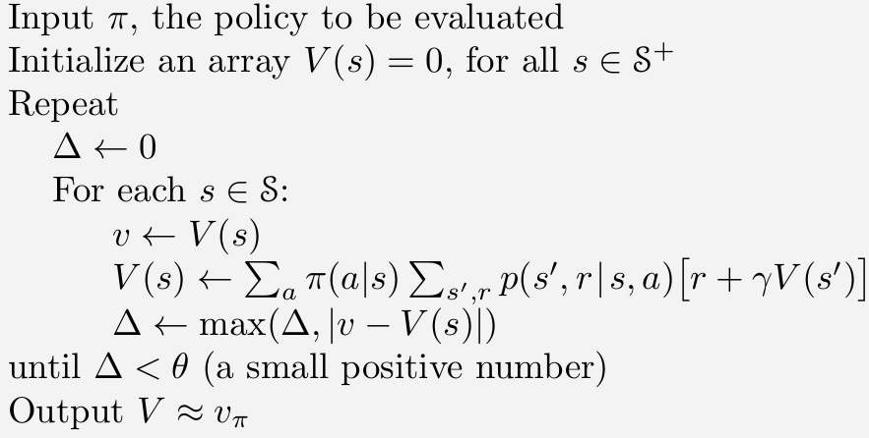
Policy Evaluation Algorithm
Iterative policy evaluation, SB pp 61
Notes:
26

Slide 27
Policy Evaluation Algorithm
Iterative policy evaluation, SB pp 61
Bellman Equation
Is this the ‘in place’ (one array) version or the two array version?
Notes:
27

Slide 28
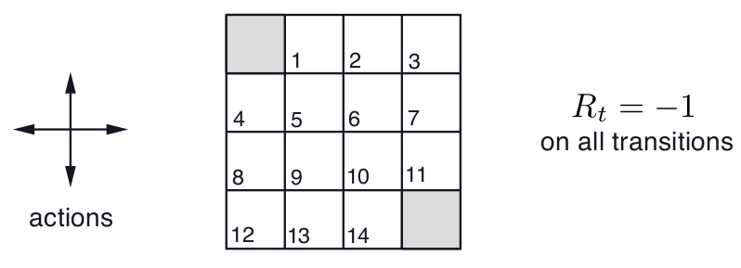
Policy Evaluation Algorithm: SB example 4.1
Terminal state
Terminal state
State transitions: deterministic
Undiscounted
Notes:
28

Slide 29
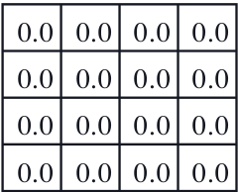
Policy Evaluation Algorithm: SB example 4.1
Initialize value function at zero
Evaluate V for a policy that selects actions uniformly randomly
Notes:
29

Slide 30
SB example 4.1
What does this value become on first iteration?
Notes:
30

Slide 31
SB example 4.1
What does this value become on first iteration?
Notes:
31

Slide 32
SB example 4.1
What does this value become on first iteration?
(b/c deterministic)
Notes:
32

Slide 33
SB example 4.1
What does this value become on first iteration?
(b/c deterministic)
Notes:
33

Slide 34
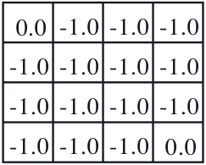
SB example 4.1
What does this value become on first iteration?
(b/c deterministic)
Notes:
34

Slide 35
SB example 4.1
What does this value become on second iteration?
(b/c deterministic)
Notes:
35

Slide 36
SB example 4.1
What does this value become on second iteration?
(b/c deterministic)
Notes:
36

Slide 37
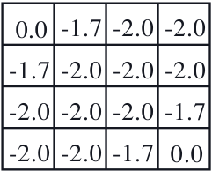
SB example 4.1
What does this value become on second iteration?
(b/c deterministic)
Why is this value NOT -1.75?
Notes:
37

Slide 38
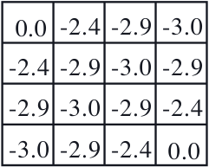
Think-pair-share
What does this value become on third iteration?
(b/c deterministic)
Notes:
38

Slide 39
SB example 4.1
What does this value become on third iteration?
(b/c deterministic)
Notes:
39

Slide 40
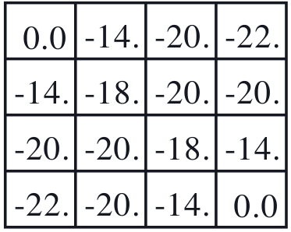
Question
Policy evaluation converges to these values
Can you think of a simple
interpretation of the values
of these states when policy
evaluation converges?
Notes:
40

Slide 41
Policy evaluation
Why does this converge?

Slide 42
Policy evaluation
Why does this converge?
Three cases
Finite-horizon undiscounted: After k steps of policy evaluation, have horizon k value
Episodic (indefinite horizon) undiscounted: If you will always reach a terminal state in a finite number of steps, see above, if only with prob 1 in the limit, see below
Infinite-horizon (discounted): After k steps of policy evaluation, have discounted horizon k value and discount causes reward value to shrink as k increases (so V^{k} will approach V^{𝜋} arbitrarily closely as k increases)

Slide 43
Policy evaluation
Why does this converge?
Three cases
Finite-horizon undiscounted: After k steps of policy evaluation, have horizon k value
Episodic (indefinite horizon) undiscounted: If you will always reach a terminal state in a finite number of steps, see above, if only with prob 1 in the limit, see below
Infinite-horizon (discounted): After k steps of policy evaluation, have discounted horizon k value and discount causes reward value to shrink as k increases (so V^{k} will approach V^{𝜋} arbitrarily closely as k increases)
Can also evaluate with a system of |S| linear equations

Slide 44
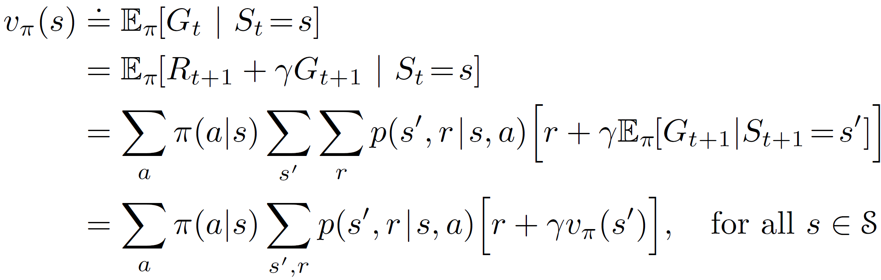
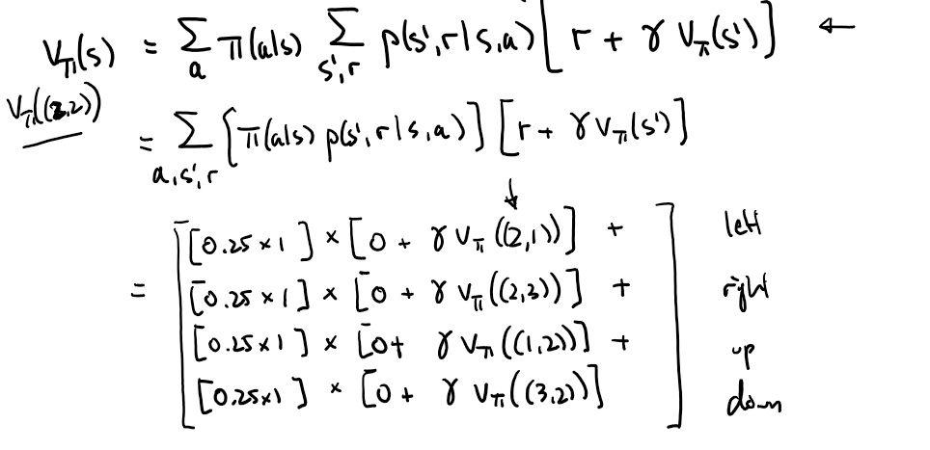
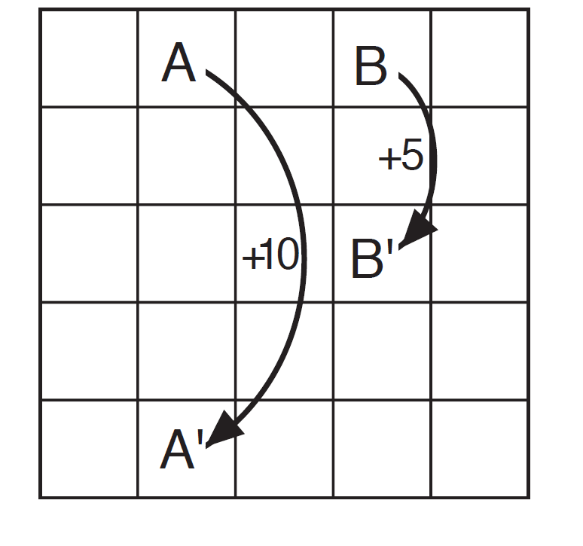
Policy evaluation
Bellman equation gives |S| linear equations (one per state) with |S| unknowns (V(s) for each state s)
Write it out

Slide 45
Policy improvement
Policy evaluation is great, but how do we use it to find better policies?
Notes:
45

Slide 46
Policy improvement
Policy evaluation is great, but how do we use it to find better policies?
Given: value function, , for a given policy
Calculate: a new policy, , that is at least as good as
Notes:
46

Slide 47
Policy improvement
Policy evaluation is great, but how do we use it to find better policies?
Given: value function, , for a given policy
Calculate: a new policy, , that is at least as good as
Policy improvement procedure:
1. calculate the value function, , for the latest policy,
2. use Q to calculate a better policy:
Notes:
47

Slide 48
Policy improvement
Policy improvement procedure:
1. calculate the value function, , for the latest policy,
2. use Q to calculate a better policy:
But, how do we calculate from ?
Notes:
48

Slide 49
Policy improvement
Policy improvement procedure:
1. calculate the action-value function, , for the latest policy,
2. use Q to calculate a better policy:
Value of being in state ,
taking action , and following
policy after that.
Value of being in state ,
and following policy
after that.
But, how do we calculate from ?
Notes:
49

Slide 50
Think-pair-share
Policy improvement procedure:
1. calculate the action-value function, , for the latest policy,
2. use Q to calculate a better policy:
But, how do we calculate from ?
Notes:
50

Slide 51
Think-pair-share
Policy improvement procedure:
1. calculate the action-value function, , for the latest policy,
2. use Q to calculate a better policy:
But, how do we calculate from ?
Hint: remember the Bellman eqn:
Use 4-tuple version
Notes:
51

Slide 52
Think-pair-share
Policy improvement procedure:
1. calculate the action-value function, , for the latest policy,
2. use Q to calculate a better policy:
But, how do we calculate from ?
Hint: remember the Bellman eqn:
Notes:
52

Slide 53
Think-pair-share
Policy improvement procedure:
1. calculate the action-value function, , for the latest policy,
2. use Q to calculate a better policy:
But, how do we calculate from ?
(SB, eqn 4.6)
Hint: remember the Bellman eqn:
Notes:
53

Slide 54
Policy Improvement
Policy improvement procedure:
1. calculate the value function, , for the latest policy,
2. use Q to calculate a better policy:
where
Notes:
54

Slide 55
Policy Improvement
Policy improvement procedure:
1. calculate the value function, , for the latest policy,
2. use Q to calculate a better policy:
where
Policy improvement theorem:
Let and be arbitrary deterministic policies such that
Then
(SB, eqn 4.7)
(SB, eqn 4.8)
Notes:
55

Slide 56
Policy Improvement
Policy improvement procedure:
1. calculate the value function, , for the latest policy,
2. use Q to calculate a better policy:
where
Policy is at least as good as
Policy improvement theorem:
Let and be arbitrary deterministic policies such that
Then
(SB, eqn 4.7)
(SB, eqn 4.8)
Notes:
56

Slide 57
Policy Improvement
If it is better to select a in s once, then it is always better to select a in s
Why does the policy improvement theorem make sense?

Slide 58
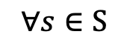
Policy Improvement
If it is better to select a in s once, then it is always better to select a in s
Policy improvement theorem proof:
$$∀s∈S$$
(by (4.6))
(by (4.7))

Slide 59
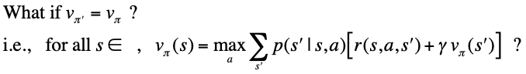
Question

Slide 60
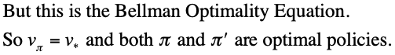
Policy Improvement

Slide 61
Policy Improvement
So can converge to an optimal policy by using policy improvement

Slide 62
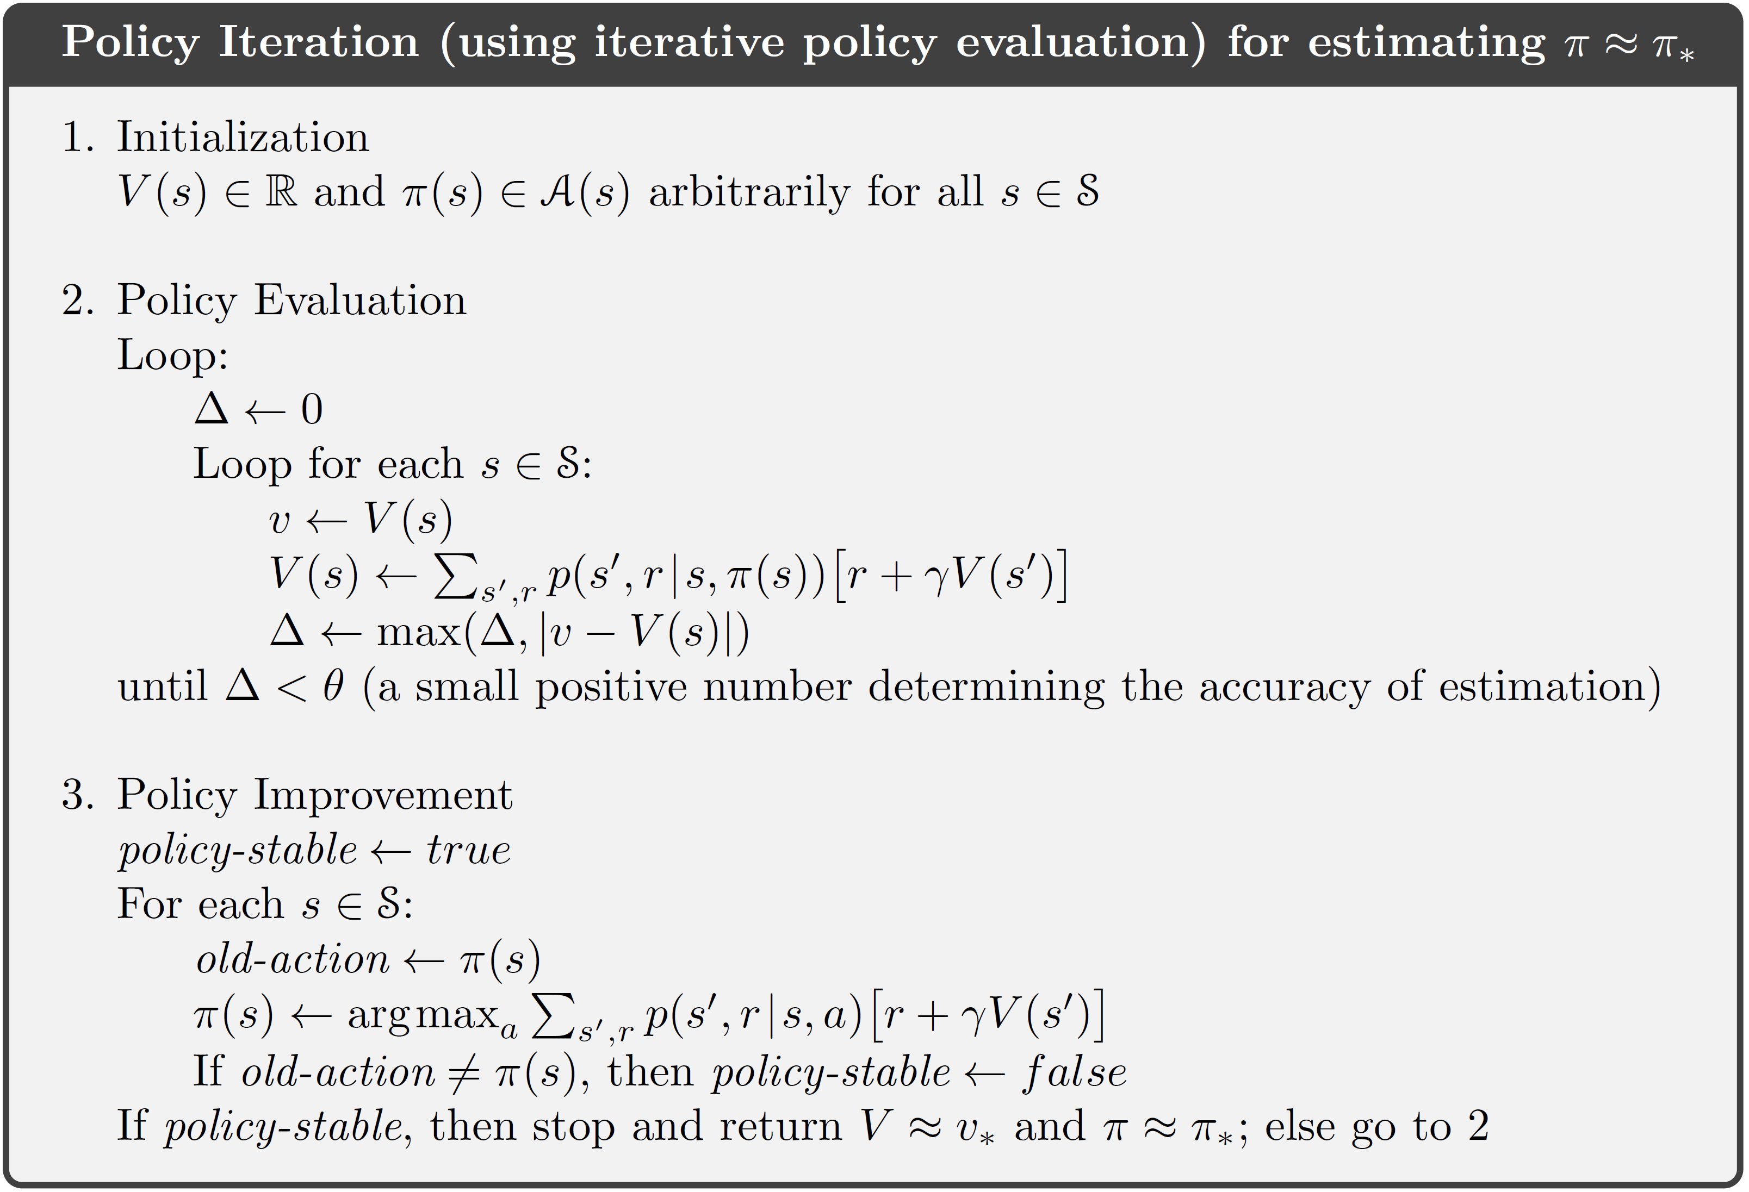
Policy Iteration

Slide 63
Policy Iteration

Slide 64
Policy Iteration

Slide 65
Policy Iteration
Guaranteed to converge to π*

Slide 66
Policy Iteration
Policy iteration: combines policy evaluation and policy improvement
Notes:
66

Slide 67
Policy Iteration
Policy iteration: combines policy evaluation and policy improvement
Arbitrary initial policy
Notes:
67

Slide 68
Policy Iteration
Policy iteration: combines policy evaluation and policy improvement
Policy evaluation
Notes:
68

Slide 69
Policy Iteration
Policy iteration: combines policy evaluation and policy improvement
Policy improvement
Notes:
69

Slide 70
Policy Iteration
Policy iteration: combines policy evaluation and policy improvement
New policy
Notes:
70

Slide 71
Policy Iteration
Policy iteration: combines policy evaluation and policy improvement
Policy evaluation
Notes:
71

Slide 72
Policy Iteration
Policy iteration: combines policy evaluation and policy improvement
Policy improvement
Notes:
72

Slide 73
Policy Iteration
Policy iteration: combines policy evaluation and policy improvement
New policy
Notes:
73

Slide 74
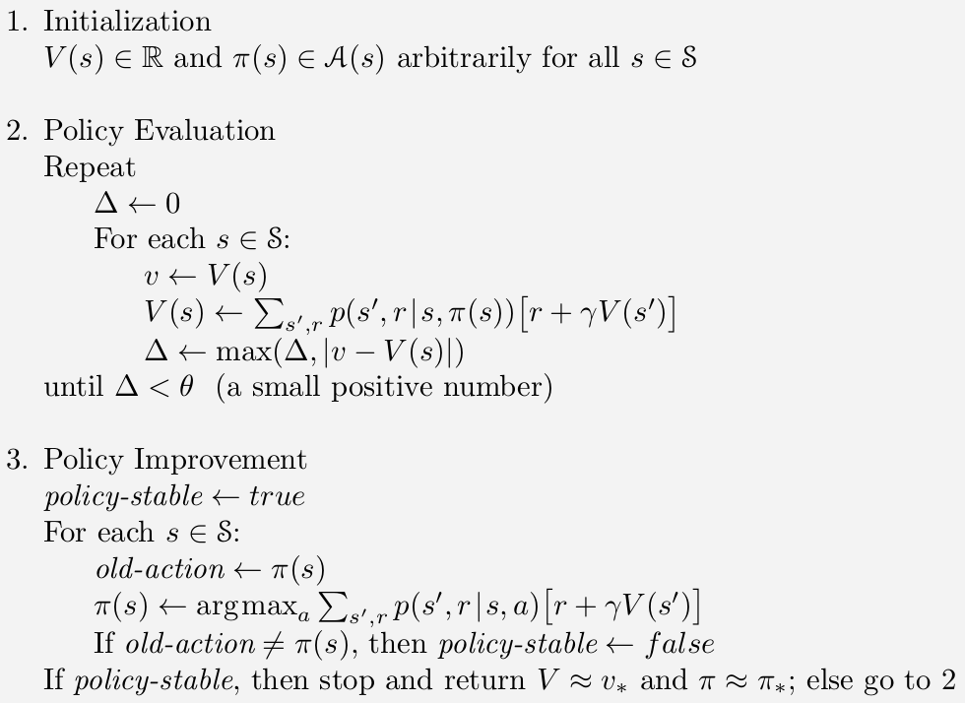
Policy Iteration
Notes:
74

Slide 75
Policy Iteration Example
Recall grid world problem from earlier:
Notes:
75

Slide 76
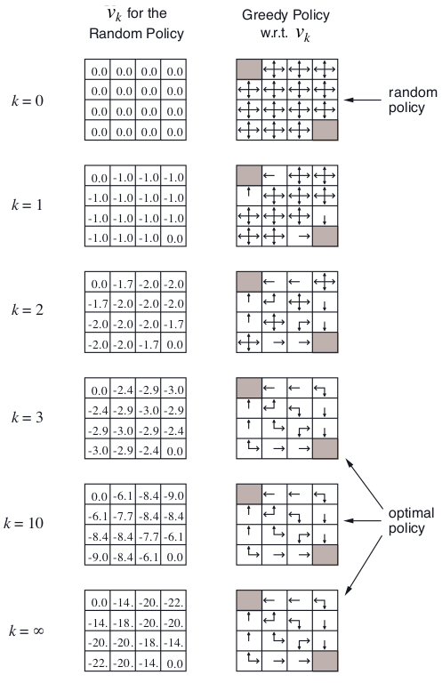
Policy Iteration Example
Recall grid world problem from earlier:
First iteration of PI:
Notes:
76

Slide 77
Policy Iteration Example
Recall grid world problem from earlier:
First iteration of PI:
Notes:
77

Slide 78
Policy Iteration Example
Recall grid world problem from earlier:
First iteration of PI:
Improved policy
Notes:
78

Slide 79
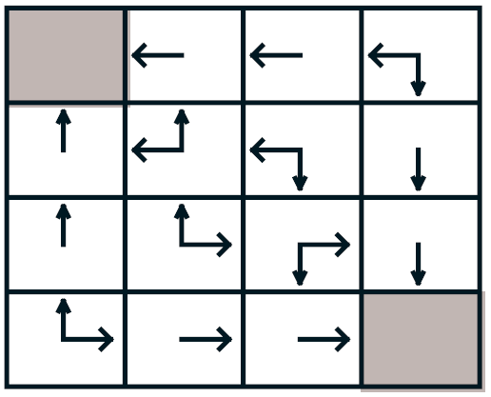
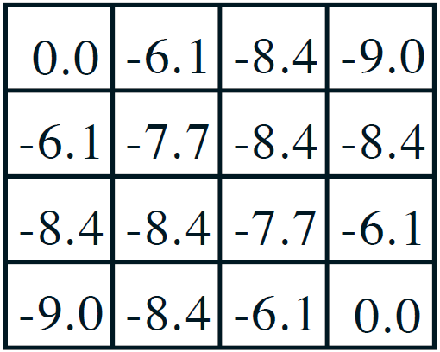
Policy Iteration Example
New policy:
2. Iterative policy evaluation 3. Policy improvement
Start from the latest value function

Slide 80
Policy Iteration Example
New policy:
2. Iterative policy evaluation 3. Policy improvement
0 | 0 | -8.35236 | -8.96732
-6.13797 | -7.7374 | -8.42783 | -8.35236
-8.35236 | -8.42783 | -7.7374 | -6.13797
-8.96732 | -8.35236 | -6.13797 | 0

Slide 81
Policy Iteration Example
New policy:
2. Iterative policy evaluation 3. Policy improvement
0 | -1 | -7.13797 | -9.35236
-1 | -7.13797 | -8.7374 | -7.13797
-7.13797 | -8.7374 | -7.13797 | -1
-9.35236 | -7.13797 | -1 | 0

Slide 82
Policy Iteration Example
New policy:
2. Iterative policy evaluation 3. Policy improvement
0 | -1 | -2 | -8.13797
-1 | -2 | -8.13797 | -2
-2 | -8.13797 | -2 | -1
-8.13797 | -2 | -1 | 0

Slide 83
Policy Iteration Example
New policy:
2. Iterative policy evaluation 3. Policy improvement
0 | -1 | -2 | -3
-1 | -2 | -3 | -2
-2 | -3 | -2 | -1
-3 | -2 | -1 | 0

Slide 84
Policy Iteration Example
New policy:
2. Iterative policy evaluation 3. Policy improvement
Values have converged! Proceed with step 3.
0 | -1 | -2 | -3
-1 | -2 | -3 | -2
-2 | -3 | -2 | -1
-3 | -2 | -1 | 0

Slide 85
Policy Iteration Example
New policy:
2. Iterative policy evaluation 3. Policy improvement
0 | -1 | -2 | -3
-1 | -2 | -3 | -2
-2 | -3 | -2 | -1
-3 | -2 | -1 | 0

Slide 86
Policy Iteration Example
New policy:
2. Iterative policy evaluation 3. Policy improvement
Policy has converged! Done.
0 | -1 | -2 | -3
-1 | -2 | -3 | -2
-2 | -3 | -2 | -1
-3 | -2 | -1 | 0

Slide 87
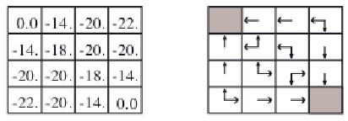
Policy Iteration Example
Recall grid world problem from earlier:
Second iteration of PI:
Notes:
87

Slide 88
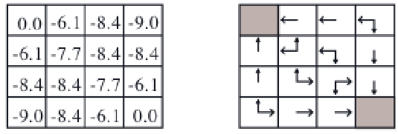
Policy Iteration Example
Recall grid world problem from earlier:
Second iteration of PI:
Improved policy
Notes:
88

Slide 89
Policy Iteration Example
Recall grid world problem from earlier:
Second iteration of PI:
Notice that we don’t need to run
PI for many steps before
the policy converges...
Improved policy
Notes:
89

Slide 90
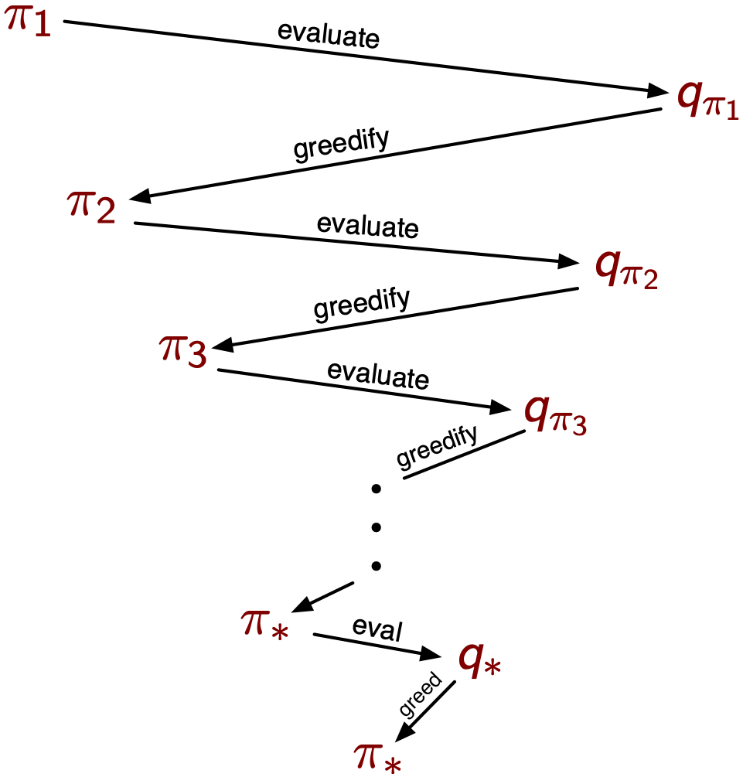
The dance of policy and value (Policy Iteration)
Any policy evaluates to a unique value function (soon we will see how to learn it)
which can be greedified to produce a better policy
That in turn evaluates to a value function
which can in turn be greedified…
Each policy is strictly better than the previous, until eventually both are optimal
There are no local optima
The dance converges in a finite number of steps, usually very few

Slide 91
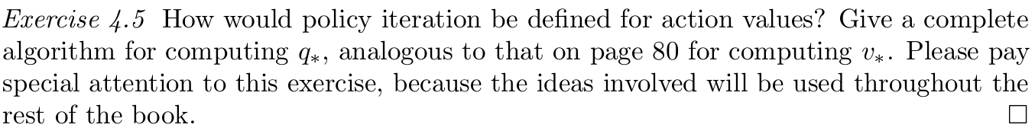
Think-pair-share
Notes:
91

Slide 92
Think-pair-share
Notes:
92

Slide 93
Stopping Policy Evaluation Early
Do we have to run policy
evaluation until convergence,
or can we stop early?
Notes:
93

Slide 94
Stopping Policy Evaluation Early
Do we have to run policy
evaluation until convergence,
or can we stop early?
We can stop early.
– how many iterations are needed?
Notes:
94

Slide 95
Stopping Policy Evaluation Early
Do we have to run policy
evaluation until convergence,
or can we stop early?
We can stop early.
– how many iterations are needed?
– it turns out that even just one works.
Notes:
95

Slide 96
Stopping Policy Evaluation Early
Do we have to run policy
evaluation until convergence,
or can we stop early?
We can stop early.
– how many iterations are needed?
– it turns out that even just one works.
– but any number is okay...
Notes:
96

Slide 97
Stopping Policy Evaluation Early
Do we have to run policy
evaluation until convergence,
or can we stop early?
We can stop early.
– how many iterations are needed?
– it turns out that even just one works.
– but any number is okay...
This is called value iteration
Notes:
97

Slide 98
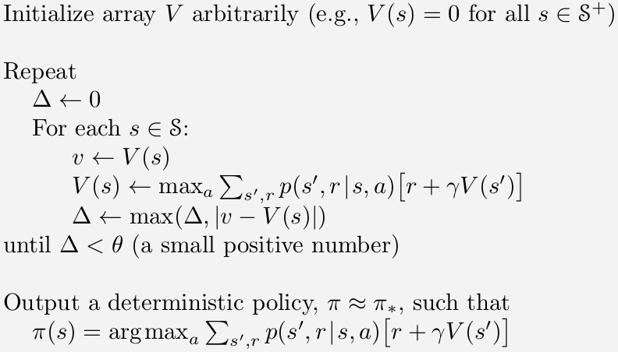
Value Iteration
Notes:
98

Slide 99
Value Iteration
Policy improvement
One step of policy evaluation
Notes:
99

Slide 100
Value Iteration
Policy improvement
One step of policy evaluation
In-place update of V(s)
Typically converges faster than two-array (old+new) version - Uses the latest value estimate
Notes:
100

Slide 101
Value Iteration
Update rule based on Bellman Eqn
Another way to understand value iteration is to see that we are iteratively
re-applying the Bellman Equation, used as an update rule.
Notes:
101

Slide 102
Value Iteration
Another way to understand value iteration is to see that we are iteratively
re-applying the Bellman Equation, used as an update rule.
1.
2.
3.
4.
5.
Notes:
102

Slide 103
Value Iteration
Another way to understand value iteration is to see that we are iteratively
re-applying the Bellman Equation, used as an update rule.
Initial value
1.
2.
3.
4.
5.
Notes:
103

Slide 104
Value Iteration
Another way to understand value iteration is to see that we are iteratively
re-applying the Bellman Equation, used as an update rule.
Value over time horizon == 1
1.
2.
3.
4.
5.
Notes:
104

Slide 105
Value Iteration
Another way to understand value iteration is to see that we are iteratively
re-applying the Bellman Equation, used as an update rule.
Value over time horizon == 2
1.
2.
3.
4.
5.
Notes:
105

Slide 106
Value Iteration
Another way to understand value iteration is to see that we are iteratively
re-applying the Bellman Equation, used as an update rule.
Value over time horizon == 3
1.
2.
3.
4.
5.
Notes:
106

Slide 107
Value Iteration
Another way to understand value iteration is to see that we are iteratively
re-applying the Bellman Equation, used as an update rule.
Value over time horizon == 3
1.
2.
3.
4.
5.
Converges to optimal value function over infinite time horizon
Notes:
107

Slide 108
Value Iteration Example
Actions: left, right, up, down
– take one action per time step
– actions are stochastic: only
go in intended direction 80% of
the time; 10% of the time go
90deg to the left, 10% of the
time go 90deg to the right.
Noise = 0.2
Discount = 0.9
Living reward = 0
Grid world:
– agent lives on grid
– always occupies a single cell
– can move left, right, up, down
– but movements are noisy/stochastic
– gets zero reward unless in “+1” or “-1” cells

Slide 109
Value Iteration Example
Noise = 0.2
Discount = 0.9
Living reward = 0

Slide 110
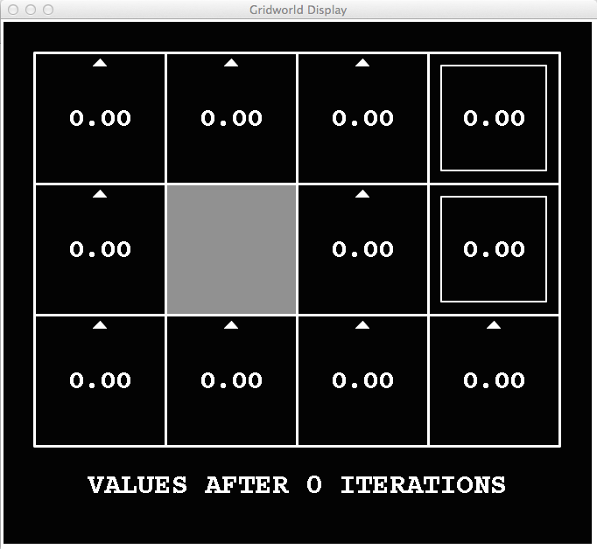
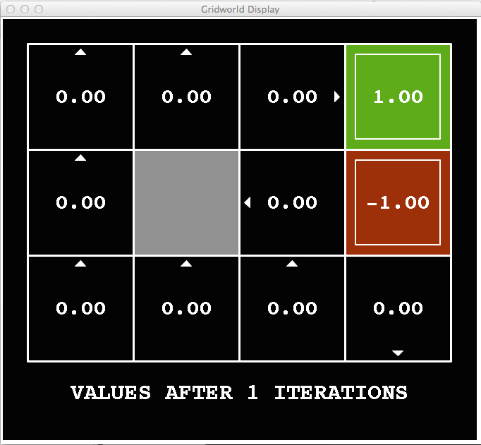
Value Iteration Example
Noise = 0.2
Discount = 0.9
Living reward = 0

Slide 111
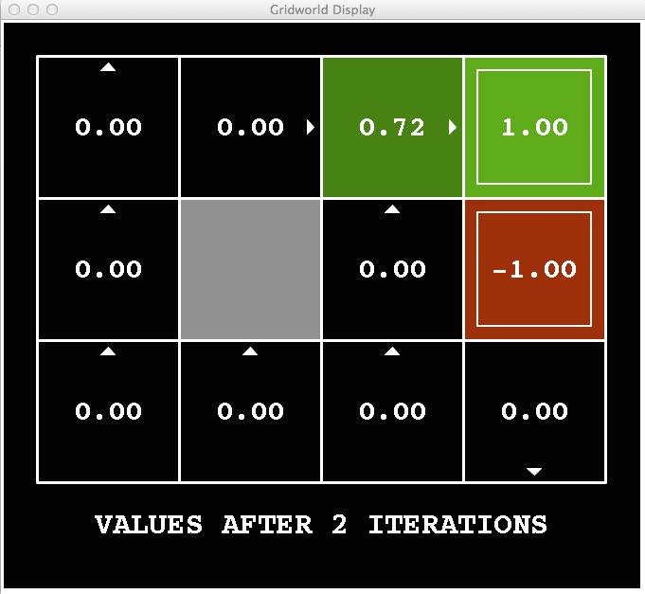
Value Iteration Example
Noise = 0.2
Discount = 0.9
Living reward = 0

Slide 112
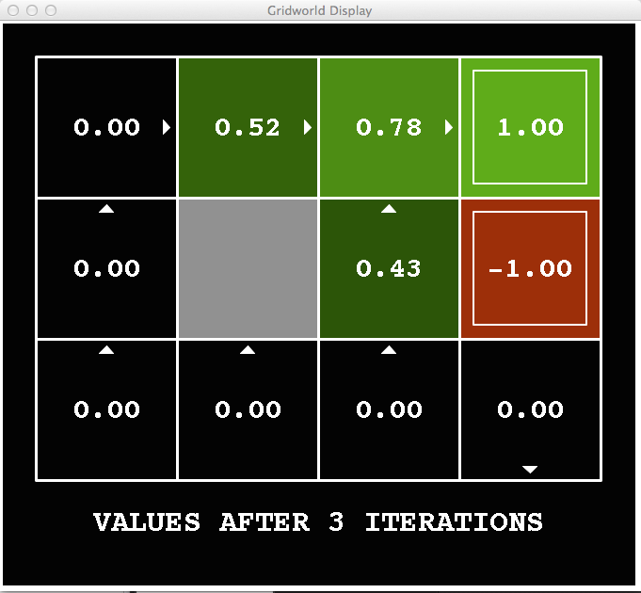
Value Iteration Example
Noise = 0.2
Discount = 0.9
Living reward = 0

Slide 113
Think-pair-share
Noise = 0.2
Discount = 0.9
Living reward = 0
What will value of this state
be on the next time step?

Slide 114
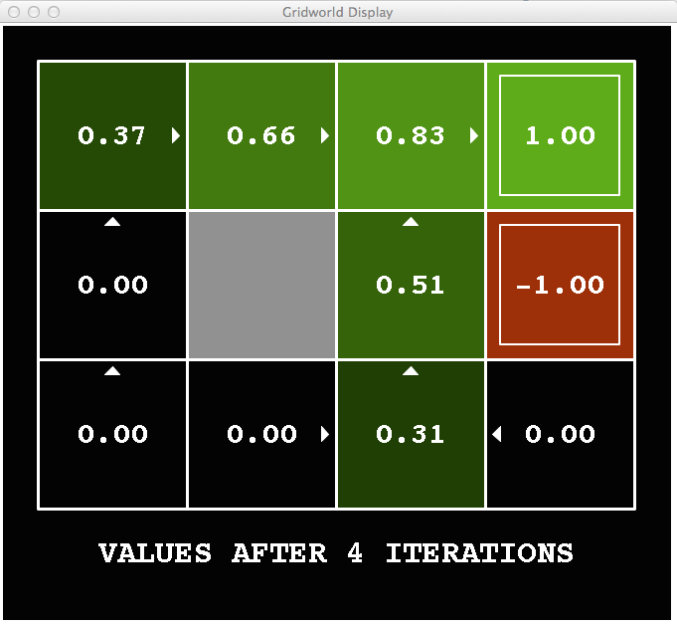
Value Iteration Example
Noise = 0.2
Discount = 0.9
Living reward = 0
.8*.9*.43

Slide 115
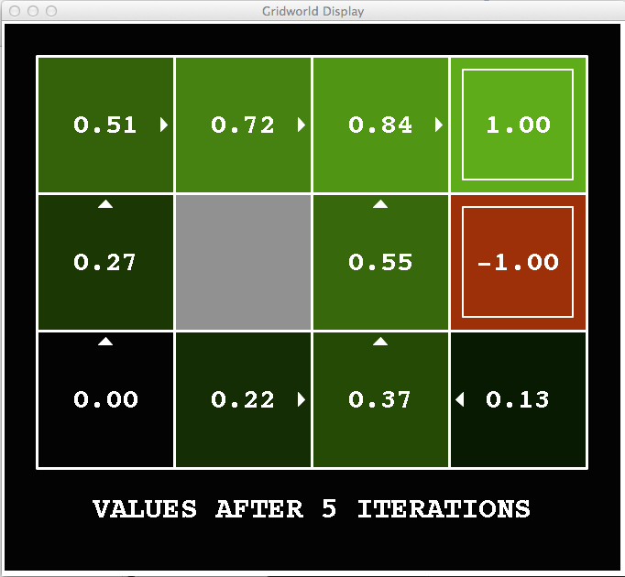
Value Iteration Example
Noise = 0.2
Discount = 0.9
Living reward = 0

Slide 116
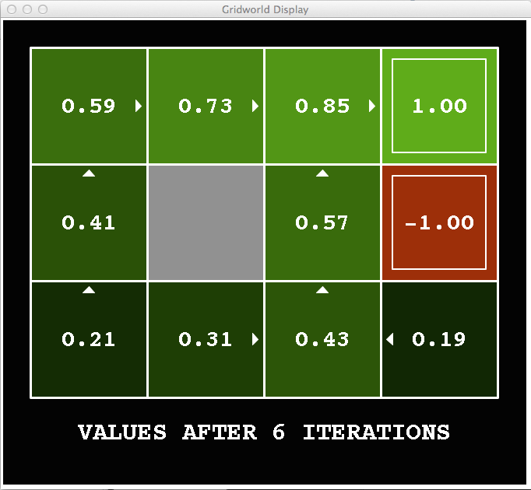
Value Iteration Example
Noise = 0.2
Discount = 0.9
Living reward = 0

Slide 117
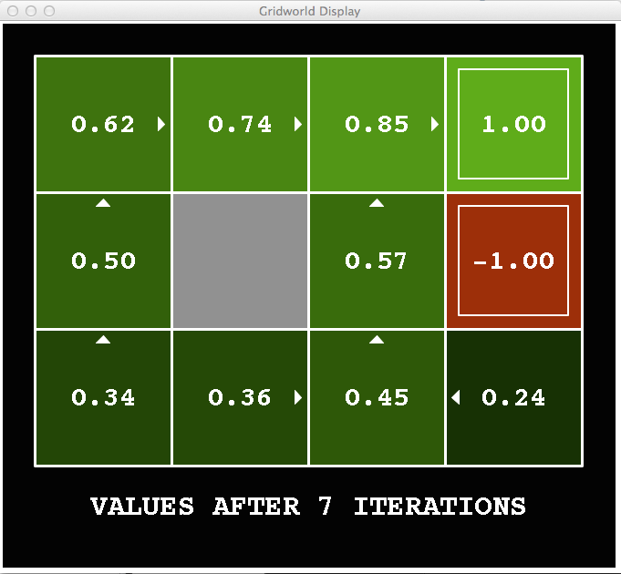
Value Iteration Example
Noise = 0.2
Discount = 0.9
Living reward = 0

Slide 118
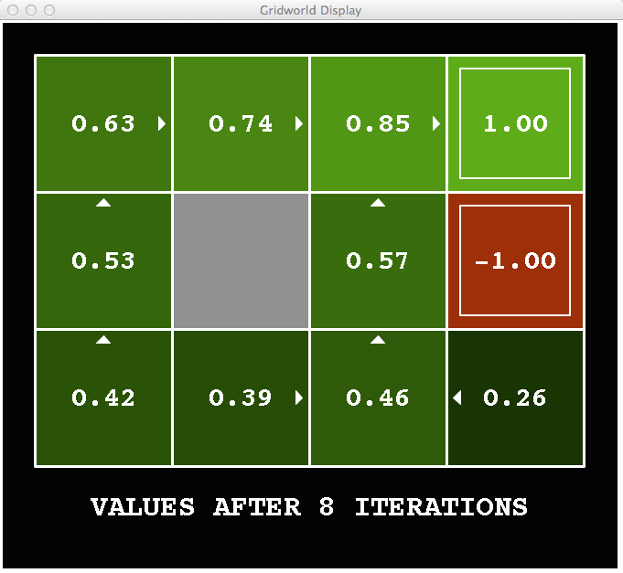
Value Iteration Example
Noise = 0.2
Discount = 0.9
Living reward = 0

Slide 119
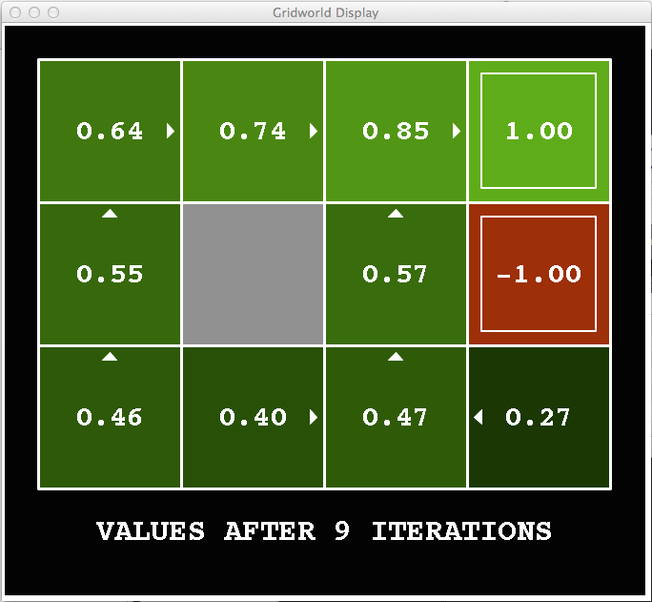
Value Iteration Example
Noise = 0.2
Discount = 0.9
Living reward = 0

Slide 120

Value Iteration Example
Noise = 0.2
Discount = 0.9
Living reward = 0

Slide 121

Value Iteration Example
Noise = 0.2
Discount = 0.9
Living reward = 0

Slide 122
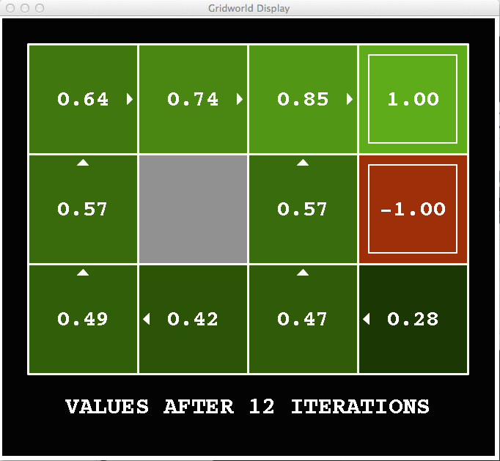
Value Iteration Example
Noise = 0.2
Discount = 0.9
Living reward = 0

Slide 123

Value Iteration Example
Noise = 0.2
Discount = 0.9
Living reward = 0

Slide 124
Value Iteration Convergence
How do we know the V_{k} vectors are going to converge?
Case 1: If the horizon has maximum depth M, then V_{M} holds the actual untruncated values (can think of this as an expectimax tree)
Case 2: If the discount is less than 1
Sketch: For any state V_{k} and V_{k+1} can be viewed as depth k+1 expectimax results in nearly identical search trees
The last layer is at most all R_{MAX} and at least R_{MIN}
But everything is discounted by γ^{k} that far out
So V_{k} and V_{k+1} are at most γ^{k} max|R_{MAX} - R_{MIN}| different
So as k increases, the values converge
V_{k+1}(s)
a
s, a
s,a,s’
V_{k}(s’)

Slide 125
Value Iteration Optimality
At convergence, this property must hold

Slide 126
Value Iteration Optimality
At convergence, this property must hold (why?)

Slide 127
Value Iteration Optimality
At convergence, this property must hold (why?)

Slide 128
Value Iteration Optimality
At convergence, this property must hold (why?)
What does this equation tell us about optimality of value iteration?
– we denote the optimal value function as:

Slide 129
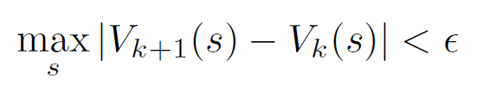
Value Iteration
Init: V(s) ← 0 for all s Repeat until convergence:
For each state s:
- Convergence: Typically (all values do not change much)
This performs 1 backup operation

Slide 130
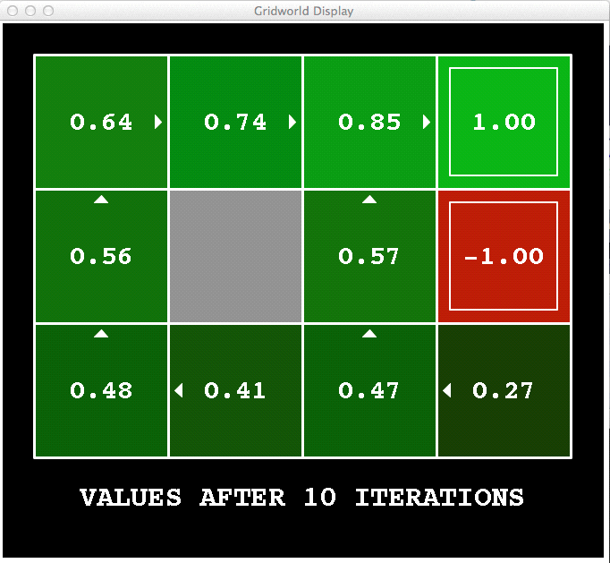
Value Iteration: Watch the policy
R(s) = 0 for non-terminal s
γ = 0.9

Slide 131
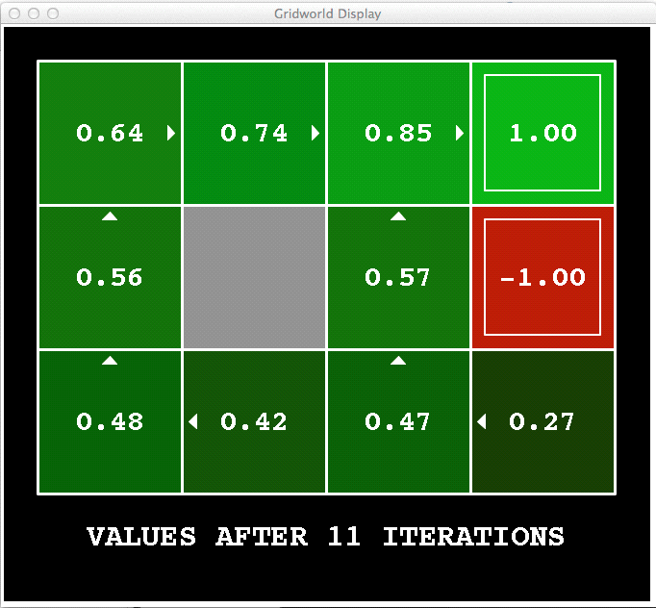
Value Iteration: Watch the policy
R(s) = 0 for non-terminal s
γ = 0.9

Slide 132

Value Iteration: Watch the policy
R(s) = 0 for non-terminal s
γ = 0.9

Slide 133

Value Iteration: Watch the policy
R(s) = 0 for non-terminal s
γ = 0.9

Slide 134
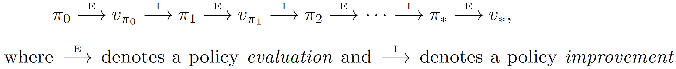
Value Iteration vs Policy Iteration
Notice anything interesting about the policy during VI? (Look at the grid-world example again)
Policy converges much faster than the value function
- Getting the exact values do not matter if the strategy to act is the same
In value iteration, we iteratively compute the value function
In policy iteration, we iteratively compute the policy

Slide 135
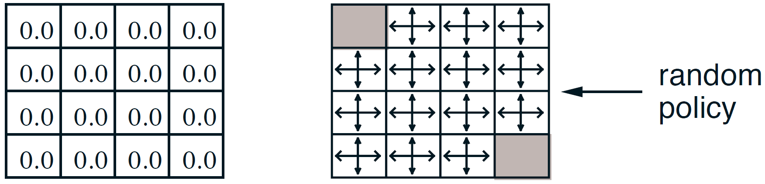
Generalized Policy Iteration
1. Initialization
- All values = 0 , policy = random
2. Iterative policy evaluation 3. Policy improvement
(values have not converged yet, but assume they are close at this point)

Slide 136
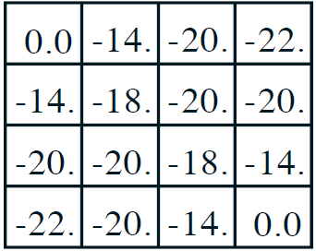
Generalized Policy Iteration
1. Initialization
- All values = 0 , policy = random
2. Iterative policy evaluation 3. Policy improvement
If we waited long enough, we get this value function

Slide 137
Generalized Policy Iteration
1. Initialization
- All values = 0 , policy = random
2. Iterative policy evaluation 3. Policy improvement
If we waited long enough, we get this value function
- The greedy policy for both is the same!

Slide 138
Variation: Generalized policy iteration
for some number of iterations k

Slide 139
Variation: Generalized policy iteration
for some number of iterations k
If k = 1, equivalent to value iteration

Slide 140
Variation: Asynchronous dynamic programming
State-update order and relative update frequency can be arbitrary, as long as all states visited infinitely often
for some number of iterations k
for some states s

Slide 141
Policy Iteration convergence
Guaranteed to converge to π*

Slide 142
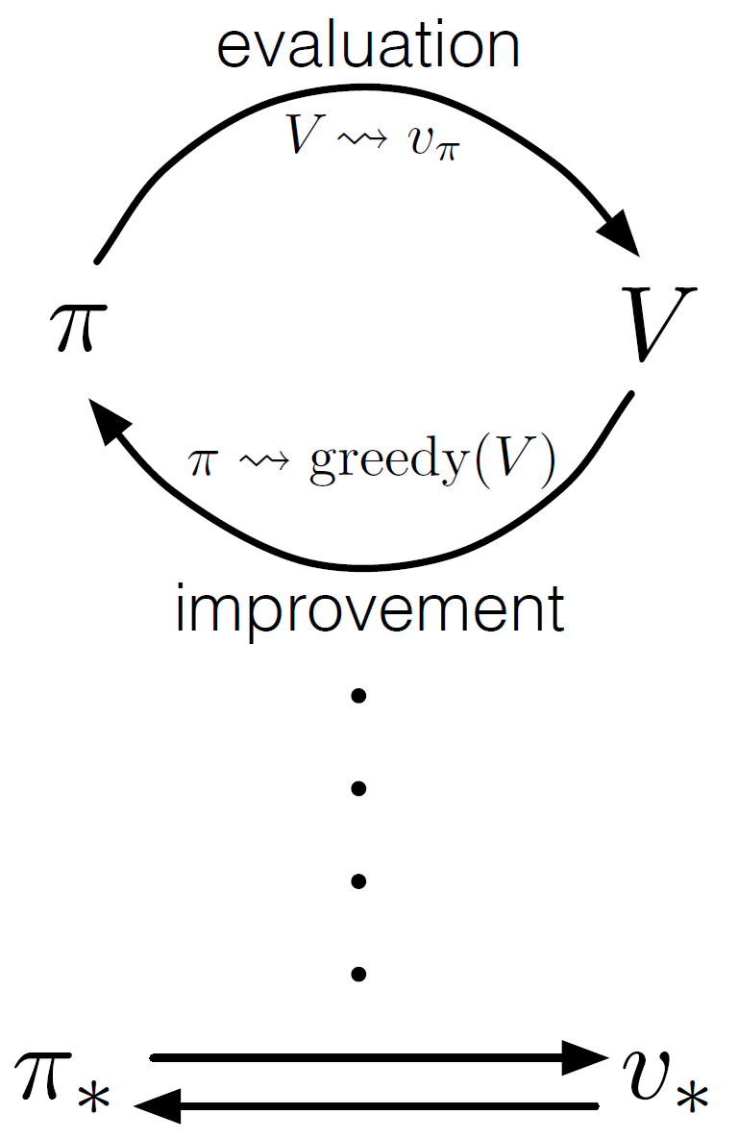
Generalized (and Asynchronous) Policy Iteration
"Almost all reinforcement learning methods are well described as GPI. [GPI = Generalized Policy Iteration] That is, all have identifiable policies and value functions, with the policy always being improved with respect to the value function and the value function always being driven toward the value function for the policy, as suggested by the diagram."

Slide 143
Computational efficiency of VI and PI
To find an optimal policy is polynomial in the number of states…
BUT, the number of states is often astronomical, e.g., often growing exponentially with the number of state variables (what Bellman called “the curse of dimensionality”)
In practice, classical DP can be applied to problems with a few millions of states
Asynchronous DP can be applied to larger problems, and is appropriate for parallel computation
It is surprisingly easy to come up with MDPs for which DP methods are not practical
Nevertheless, VI and PI are the basis for many more scalable algorithms that we will discuss next

Slide 144
Summary: Dynamic programming
- Value iteration
- Policy evaluation
- Policy iteration
"Almost all reinforcement learning methods are well described as generalized policy iteration.”

Slide 145
Next time
Monte Carlo methods
Getting rid of the assumption of a known model (i.e., P(s’|s,a) and R(s,a))

